Slide 1
Bayesian Multilevel Analysis of Housing Prices in Major Ontario Cities
How do interest rates, international student enrollment, and housing supply interact to drive housing prices across major Ontario cities?
MSE 718 Term Project – Group 6
Henry A. Tetteh
Aymen Mehrez
Gary Zang

Slide 2
Data Sources
File | Contents | Aggregation
Housing_price_index.csv | Statistics Canada NHPI (18-10-0205-01) | Monthly → annual mean
Interest_rate.csv | Bank of Canada daily overnight-rate target | Daily → annual mean
International_students.csv | StatCan 37-10-0232-01 — postsecondary enrolment by institution | Annual sum per CMA
New_houses_built.csv | CMHC housing starts by CMA | Monthly → annual sum

Slide 3
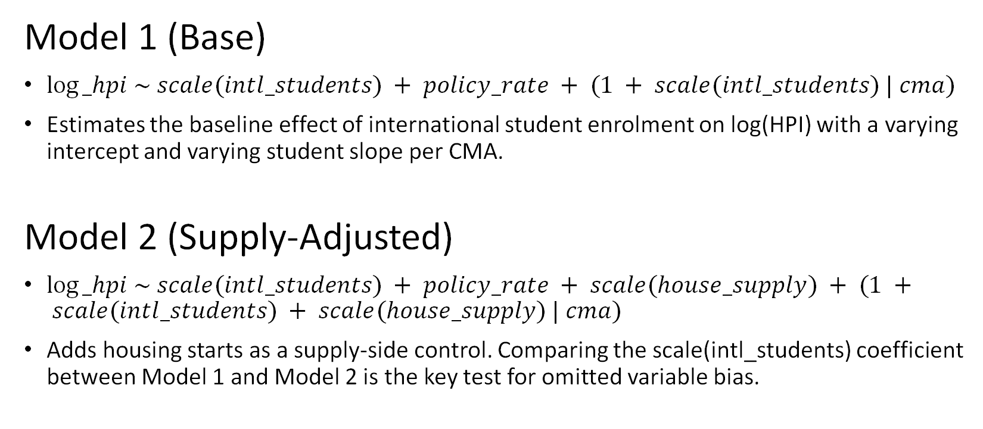
Bayesian Model
Model 1 (Base)
$log⁡_hpi \sim scale(intl_students) + policy_rate + (1 + scale(intl_students) | cma)$
Estimates the baseline effect of international student enrolment on log(HPI) with a varying intercept and varying student slope per CMA.
Model 2 (Supply-Adjusted)
$log⁡_hpi \sim scale(intl_students) + policy_rate + scale(house_supply) + (1 + scale(intl_students) + scale(house_supply) | cma)$
Adds housing starts as a supply-side control. Comparing the scale(intl_students) coefficient between Model 1 and Model 2 is the key test for omitted variable bias.

Slide 4
Priors
Parameter | Prior | Rationale
Intercept | normal(4.8, 0.5) | log(HPI) spans 4.57–5.15; weakly informative anchor
scale(intl_students) | skew_normal(0.1, 0.1, 3) | Students need housing → upward demand pressure; data can override
policy_rate, scale(house_supply) | normal(0, 0.5) | Weakly informative, no directional assumption
Group-level SD | exponential(1) | Controls shrinkage across 6 CMAs
Residual SD | exponential(1) | Regularises unexplained year-to-year variation
Intercept-slope correlation | lkj(2) | Random effects correlation matrix

Slide 5
Results
Variable | N | Mean | SD | Min | Max
Price index | 48 | 116.93 | 20.05 | 96.62 | 173.02
log(HPI) | 48 | 4.749 | 0.157 | 4.571 | 5.153
Policy rate (%) | 48 | 1.479 | 1.378 | 0.250 | 4.743
International students | 48 | 24,132 | 26,050 | 3,708 | 105,729
Housing starts | 48 | 125.91 | 165.99 | 22.54 | 571.05
Table 1: Panel overview
Parameter | Model 1 |  | Model 2
 | Mean | 95% CI | Mean | 95% CI
Intercept | 4.898 | [4.4884, 5.3305] | 4.9343 | [4.5196, 5.3431]
International students (std.) | 0.2111 | [0.0877, 0.3862] | 0.2141 | [0.092, 0.3765]
Policy rate | -0.0343 | [-0.0616, -0.0026] | -0.0166 | [-0.053, 0.0271]
Housing starts (std.) | -- | -- | 0.1958 | [-0.162, 0.6608]
Table 2: Main posterior estimates

Slide 6
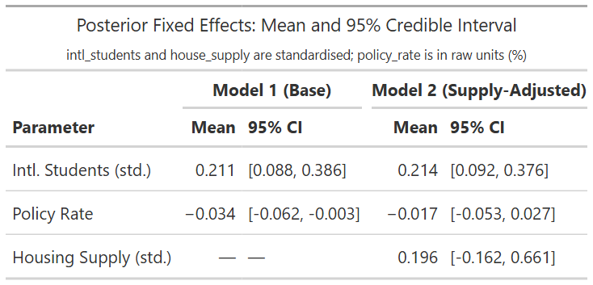
Results

Slide 7
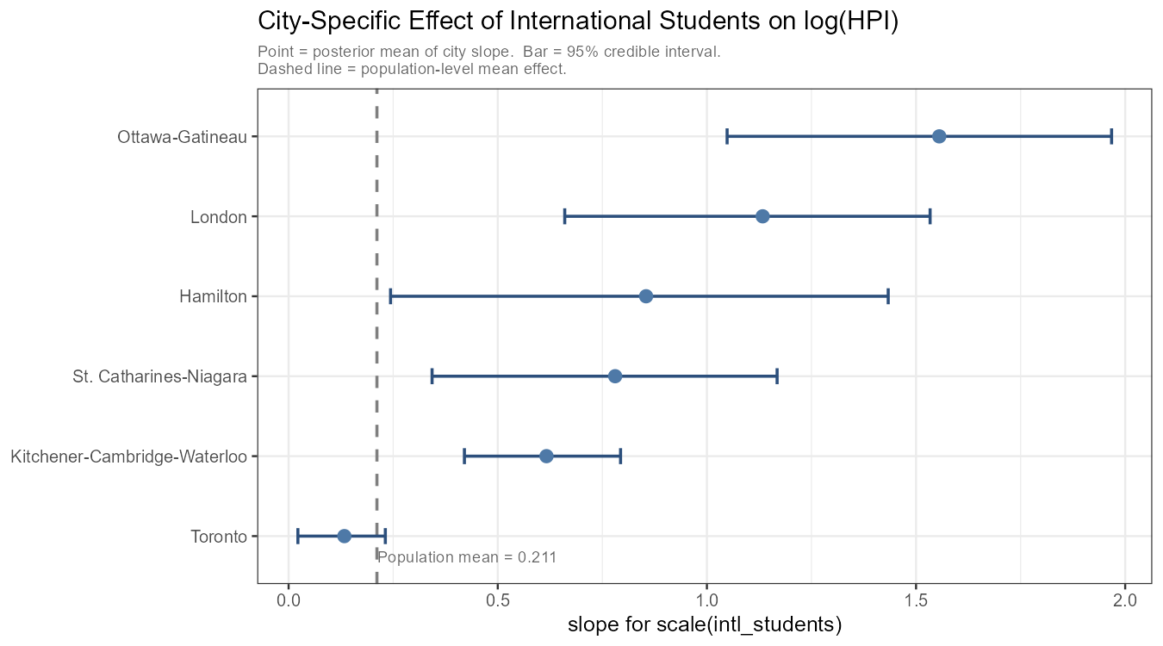
Figures
Figure 1: City-specific posterior slopes for the effect of international student enrollment on log(HPI) in Model 1.

Slide 8
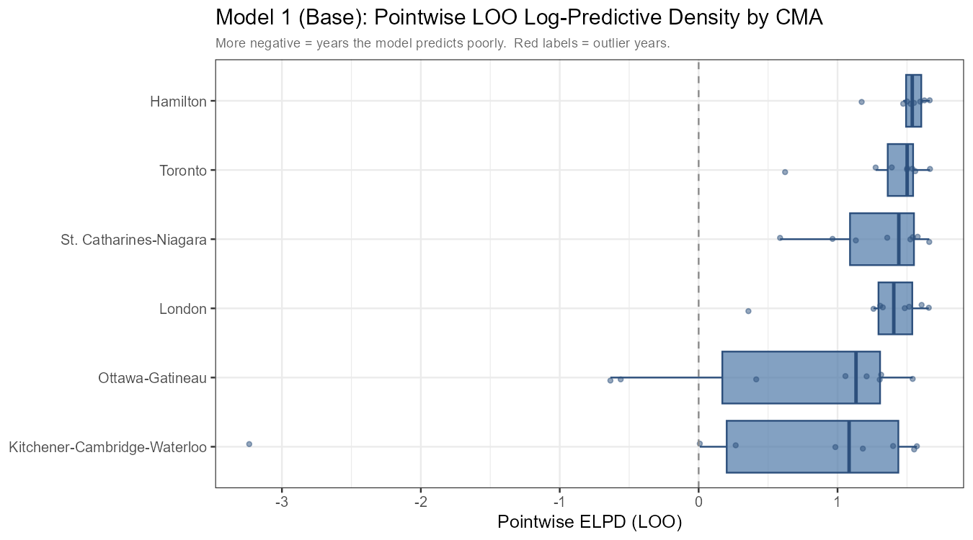
Figures
Figure 2: Pointwise PSIS-LOO log predictive density by CMA for Model 1.

Slide 9
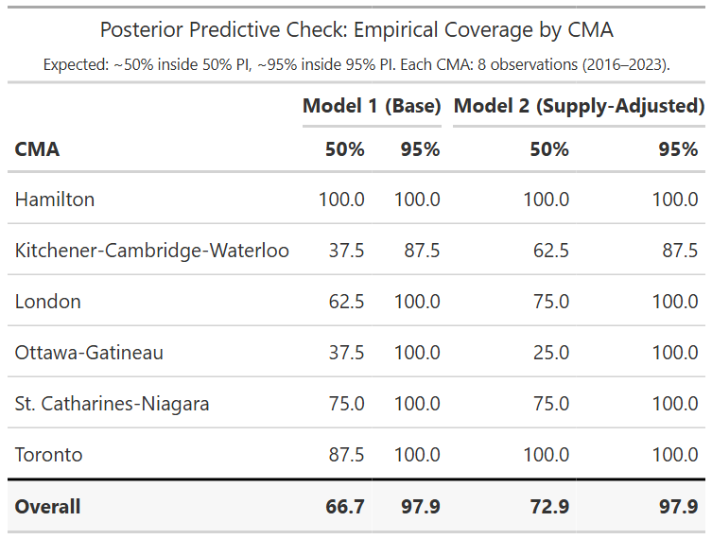
Results

Slide 10
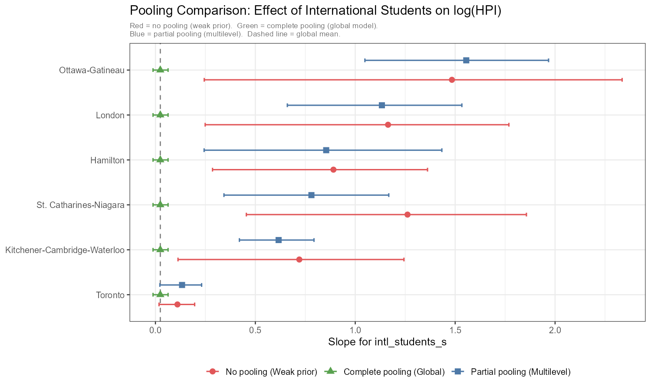
Figures
Figure 3: Comparison of no pooling, complete pooling, and partial pooling estimates for the international-student effect.

Slide 11
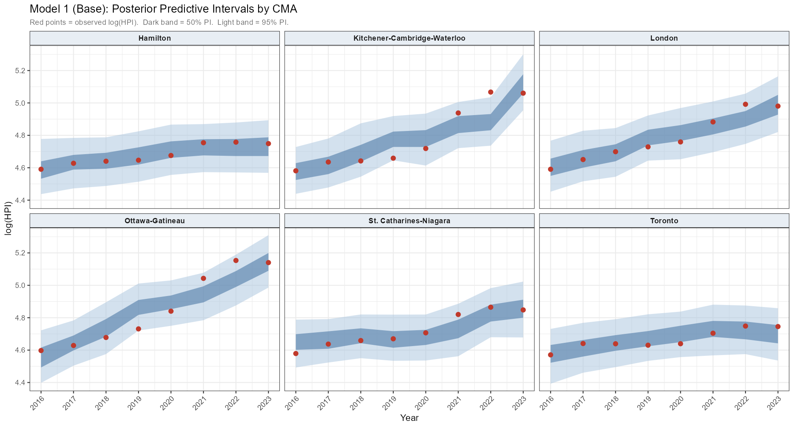
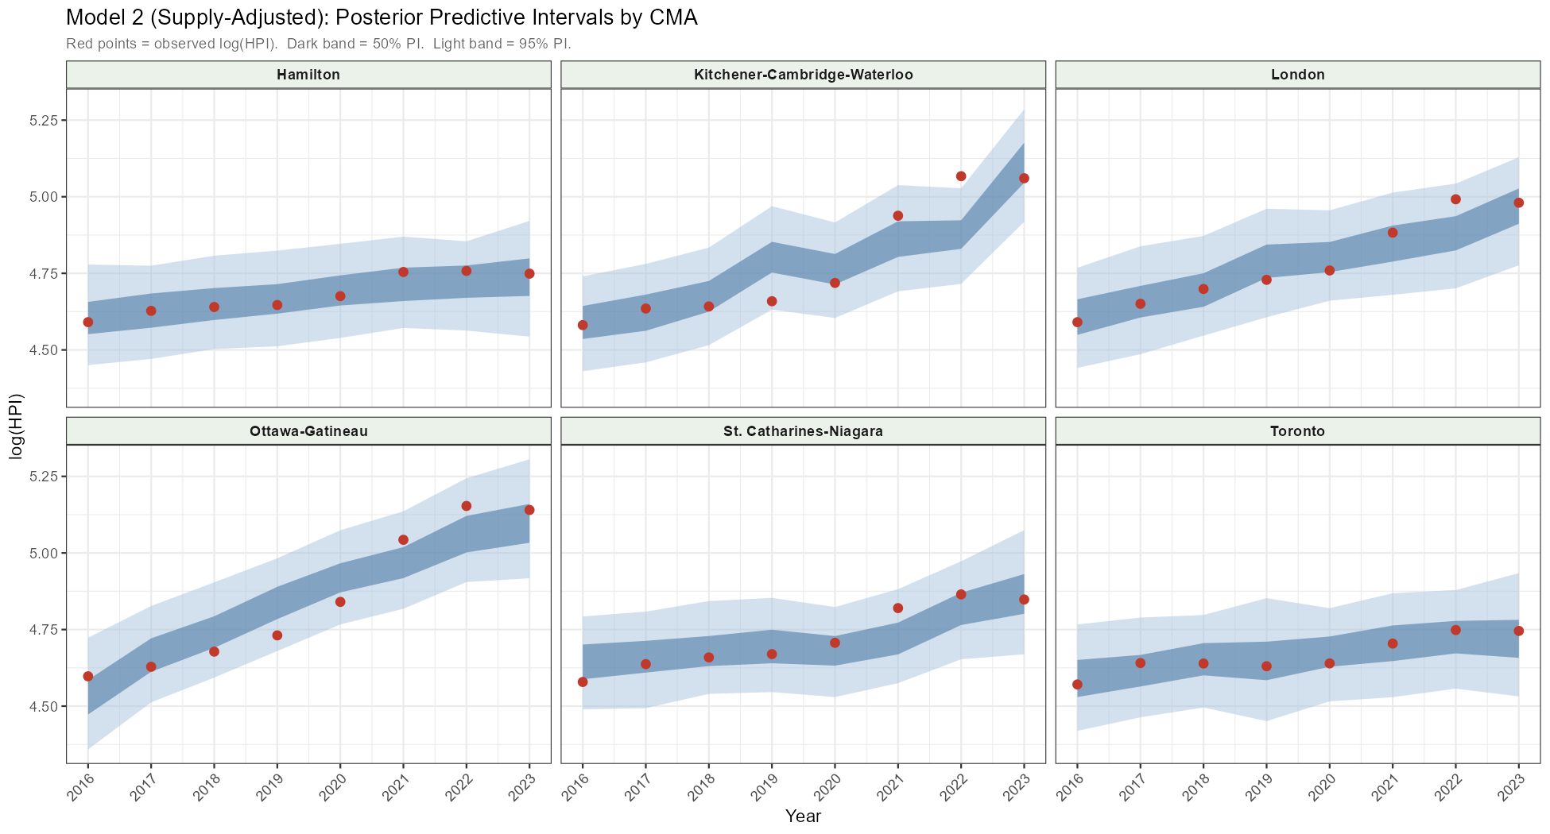
Figures
Figure 4-5: Posterior predictive intervals by CMA for Model 1 (left) and 2 (right).

Slide 12
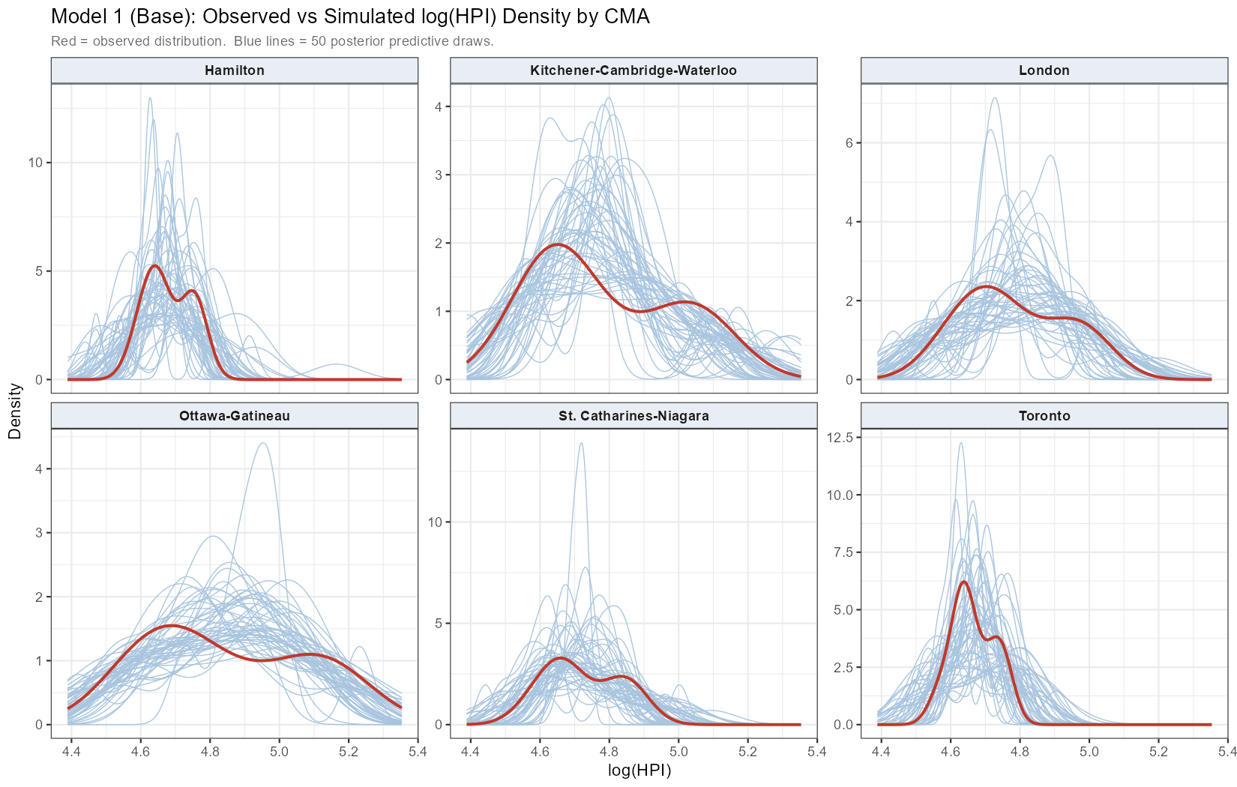
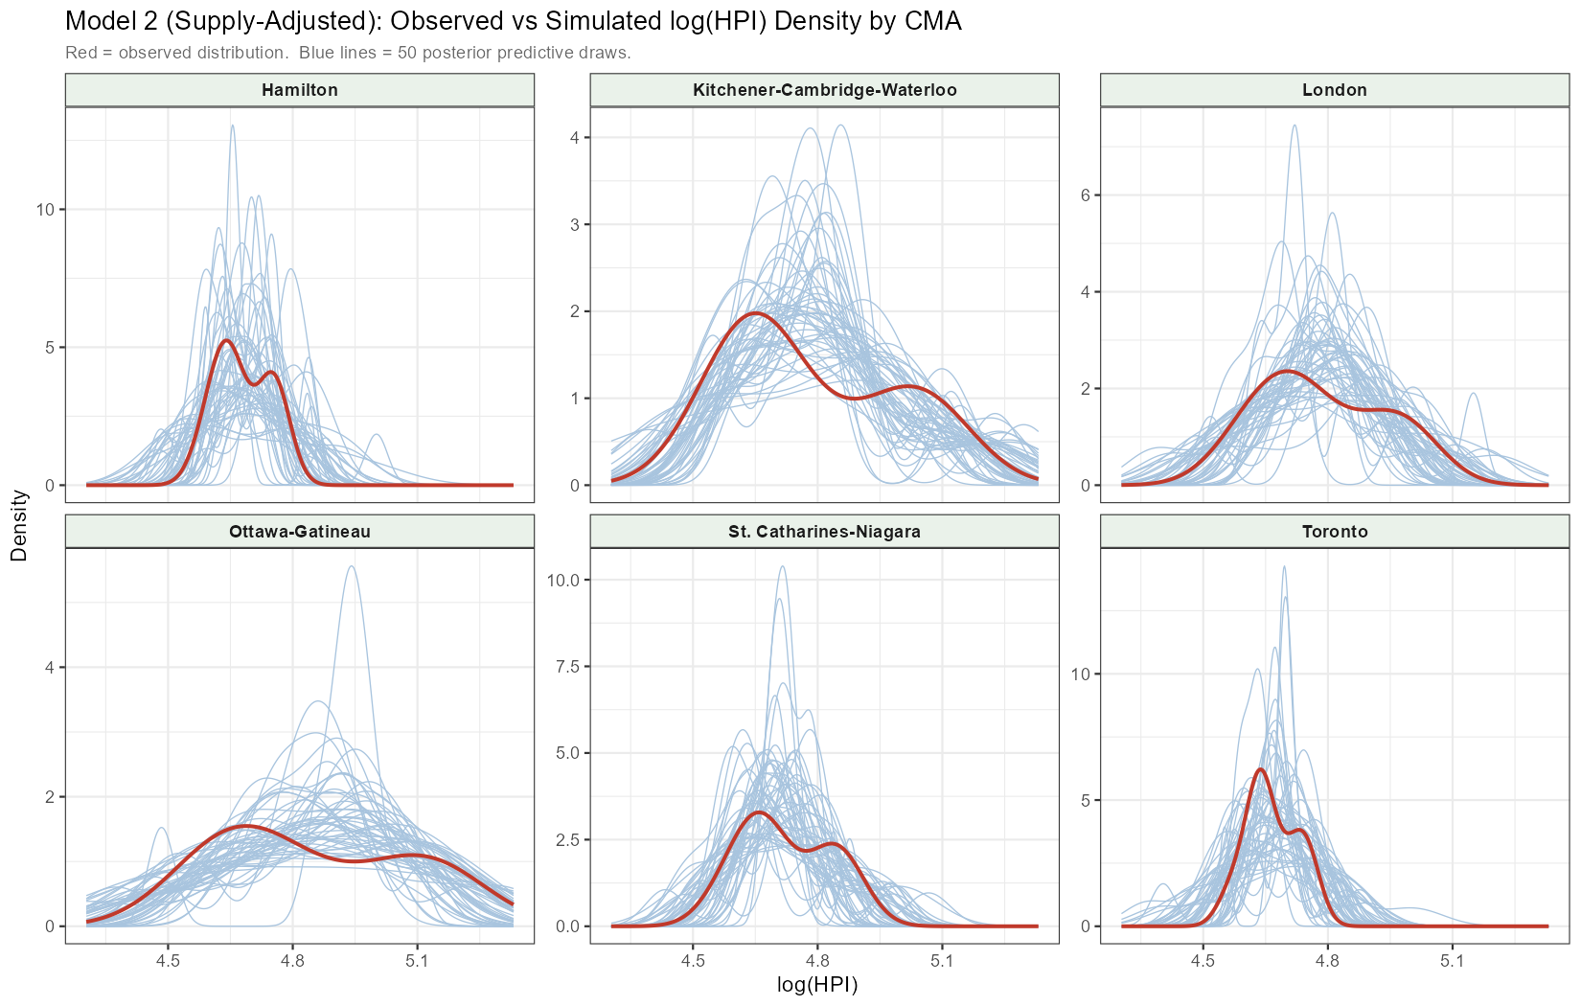
Figures
Figure 6-7: Observed and posterior predictive densities of log(HPI) by CMA for Model 1 (left) and 2 (right).

Slide 13
Summary
Conclusion: International student enrolment is positively associated with housing prices and policy rates are generally associated with lower prices, while housing supply does not show a clear independent effect in this dataset.
Model Comparison: PSIS-LOO favors the simpler baseline model, since Model 2 adds complexity but performs worse out of sample (elpd_loo = 49.4 vs 53.4 for Model 1).
Heterogeneity Across CMAs: The student-enrolment effect is not uniform across cities, appearing strongest in Ottawa-Gatineau and London and weakest in Toronto.
Limitations: The results are associational rather than causal because the panel is small and annual, the predictors are highly collinear, and the diagnostics still show some influential observations and sampling warnings.

